Slide 1
MDT – Malt deployment toolkit
Phil Schwan
Solution Architect
Netrix LLC
Fred Bainbridge
Systems Consultant
Now Micro

Slide 2
Phil Schwan
Fred Bainbridge
@philschwan
@FredBainbridge
MCSE: Enterprise Devices & Apps, Mobility
Fantasy Baseball Champion
Almost 20 years desktop engineering
1 Year of Brewing
Running and Brewing FTW
Beer. (Not too cool for an IPA)

Slide 3
agenda
LET’S MAKE SOME BEER!

Slide 4
agenda
Why do we brew?
Brewing Basics - How does one brew?
Advanced Brewing – How do I take it to the next level?
Tips and Tricks

Slide 5
“This is actually good”
-People who drink your homebrew

Slide 6
Getting started - WHY
Why brew your own beer?
It’s actually easy to make good beer
Satisfaction of doing it yourself
Can be simple or complicated
Ample opportunity to geek out
Can actually save you money in the long run
Process hasn’t fundamentally changed in thousands of years
Notes:
Easy – Good beer is easy to make. Great beer is REALLY HARD to make
Satisfaction – The beer is that much more enjoyable when you brewed it, and it’s a lot more fun to share with your friends
Simple or Complicated – From extract SMASH to triple decoction Belgian quad aged in bourbon barrels.
Geeky – Recipe design, process documentation, automation, equipment…you can totally geek out with this hobby
Money – There’s some startup cost, and like any hobby you can really go all in and buy expensive equipment. You can also brew KBS clones for $1.50/bottle.
Timeless – If you have to step away, you can still buy good craft beer or enjoy others’ and when you have time again you can pick right back up

Slide 7
Brewing Basics
How does this all work?

Slide 8
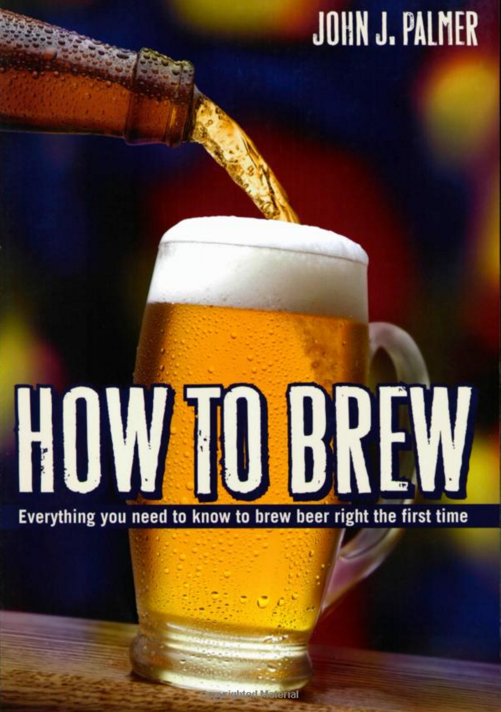
Getting started - TIPS
Read this book.
Online for free
http://howtobrew.com/
4th edition shipping now.
Notes:
This book is the equivalent of learn powershell in a month of lunches.

Slide 9
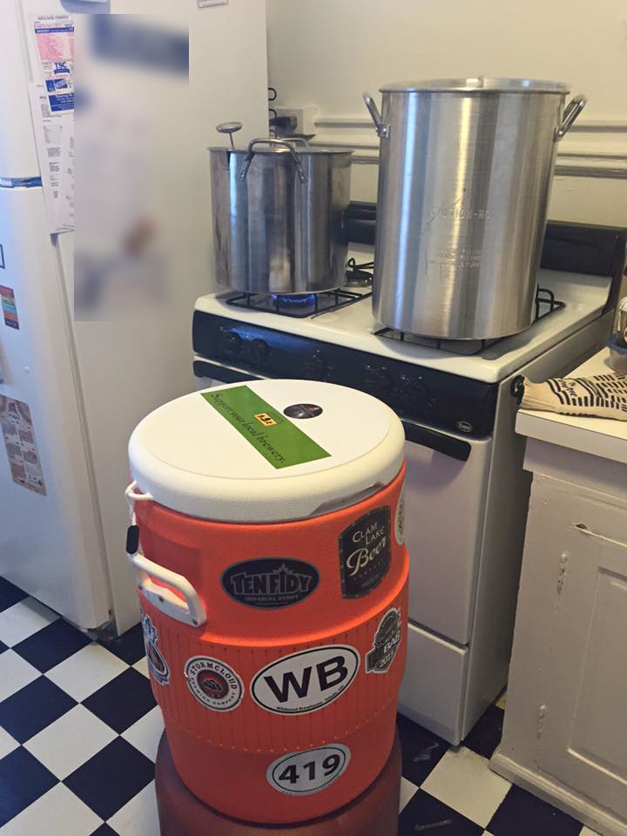
Getting started - TIPS
Don’t over do it on the equipment
Look on Craigslist for equipment!
Build your own stuff.
Keep it simple! S.M.A.S.H.
Single Malt and Single Hops
(You won’t take this advice, its ok)
Notes:
Start with simple equipment because if you don’t like brewing you haven’t lost much. Better equipment doesn’t make better beer. Good brew process makes for a better beer, good equipment makes for a comfortable / scalable brew. Easy cleanup, etc.
When building your equipment be prepared too go to your local hardware store 8-10 times. It is fun to ask for help, the staff generally get excited when they know they are helping someone brew beer.
Starting simple has a few benefits. It takes some time to get your process down as far as equipment and workspace go. Your first brews you going to be highly sensitive to your environment and process, no need to add the overhead of a complex beer recipe. Save the complexity for when you are comfortable with your workspace and equipment and you don’t have to constantly be thinking about it. That’s the time you want to start looking at making a complex beer.

Slide 10
Brewing Basics
How to Brew
1. Mash - Extract sugar from grain using hot water to make wort.
2. Boil – Cook for 60-90 minutes. Add hops occasionally.
3. Chill - Cool the boiled wort.
4. Pitch - Add yeast and let magic happen!
5. Store/Serve - Bottle or keg.
Notes:
We are going to be talking about all grain brewing. It is way more fun. Extract brewing is great, you can make good beer with extract brewing. But, again, grain brewing is more fun.
Here is how you

Slide 11
Brewing Basics – METHODS
Brewing Methods
Extract – Somebody else mashes so you don’t have to
Partial Mash – Somebody else mashes, but you need something extra
Brew in a Bag – You’re impatient, have a giant pot and a spare winch laying around
All Grain – Willing to spend the extra time for the extra control
Homebrewing is typically done in 5gal/19L batches
Notes:
Extract – Base grains are mashed in bulk to create wort; wort is boiled down to syrup or dehydrated into powder. No concern for temperature.
Partial Mash – Bulk of the sugar from extract, but steeping specialty grains for color, mouth feel, etc. Small amount of grain, so temp important but not critical.
Brew in a Bag – Mash everything in a giant bag, pull out the bag and proceed with the boil. Less efficient/flexible than traditional all grain, but also faster and no sparge/transfer.
All Grain – Mash grains, stepping through temps as needed. Drain/sparge, then proceed with boil.
From the start of boil through the finished beer, all four processes are the same. From here on out, we’ll be talking mostly about All Grain brewing

Slide 12
BREWING BASICS - EQUIPMENT
Equipment Used to Brew
Basics
Mash tun – Insulated container (cooler) for holding grains at temp during mash
Boil kettle – Stock pot to boil wort
Racking cane – Siphon to transfer wort to fermentation vessel
Fermentation bucket – Usually plastic
Wort chiller – Quickly cool your wort
Notes:
Mash tun – Recommend at least 10 gal capacity cooler. Easy to convert with a ball valve, a couple washers and a SS braided water line
Boil kettle – Recommend at least 8 gal for all grain, you need room to boil down to approx. 6 gal
Racking cane – Get an auto-siphon and hose. So much easier.
Fermentation bucket – Plastic is fine as long as it seals, just don’t scratch it.
Wort chiller – Immersion, counterflow, plate

Slide 13
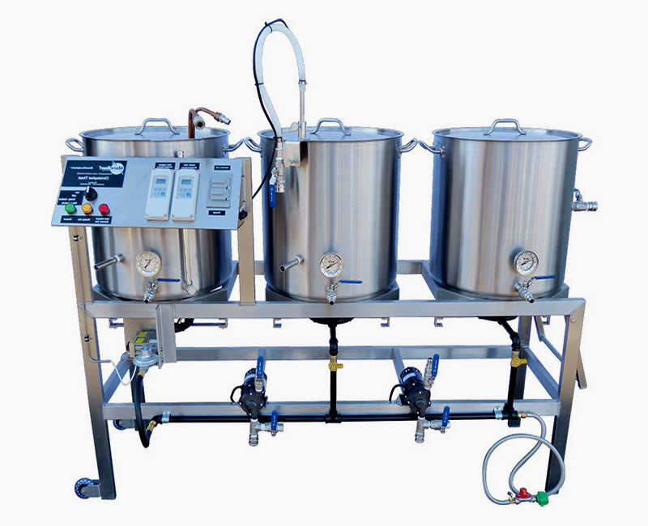
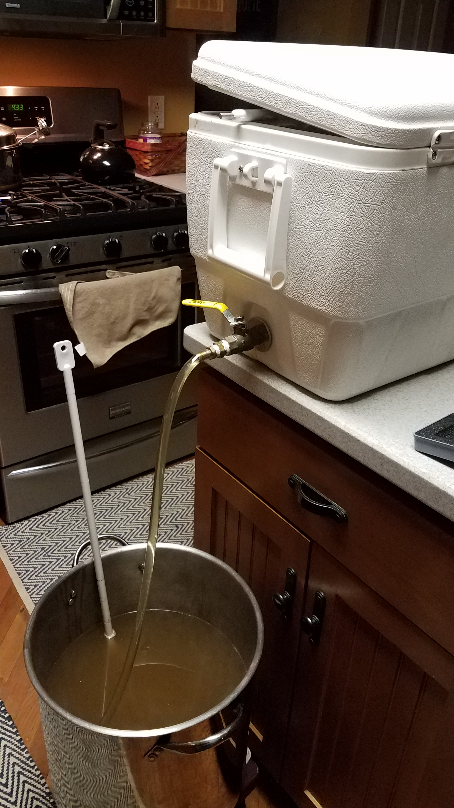
BREWING BASICS - EQUIPMENT
Equipment we want to brew with…
Equipment we actually brew with…
Notes:
Mash tun – Recommend at least 10 gal capacity cooler. Easy to convert with a ball valve, a couple washers and a SS braided water line
Boil kettle – Recommend at least 8 gal for all grain, you need room to boil down to approx. 6 gal
Racking cane – Get an auto-siphon and hose. So much easier.
Fermentation bucket – Plastic is fine as long as it seals, just don’t scratch it.
Wort chiller – Immersion, counterflow, plate

Slide 14
BREW DAY!!
It’s a great day.
Notes:
We are going to walk through a bew day in great detail here. Stopping to talking in detail about the process and equipment.

Slide 15
Brew Day Tips
Give yourself enough time.
Have patience.
Have a clean workspace.
Be prepared.
Notes:
Extra tip: Don’t drink four Russian Imperial Stouts while you’re brewing.

Slide 16
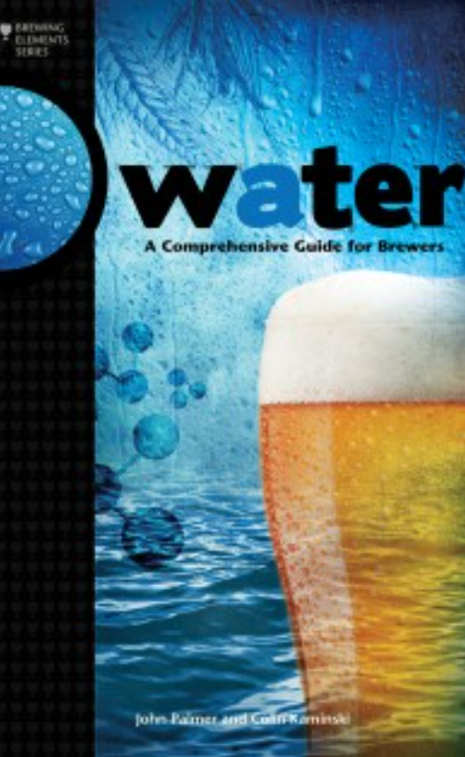
The night before (WATER PREP)
Water. Your first opportunity to geek out.
Get a water report, you have to call for this
Water profile can dictate what beers you can make well.
BOOK: Water: A Comprehensive Guide for Brewers
Spring water good. Distilled water bad.
Pour the water the night before
Bypass your water softener! (unless you want a salty beer)
Chlorine tastes bad. Leave water out over night to dissipate.
Did you forget? Camdem Tablets (potassium metabisulfite)
Ascorbic acid/Vitamin C to eliminate chloramine
Notes:
Some water can’t make some beers. This is a hard truth you may have to deal with.

Slide 17
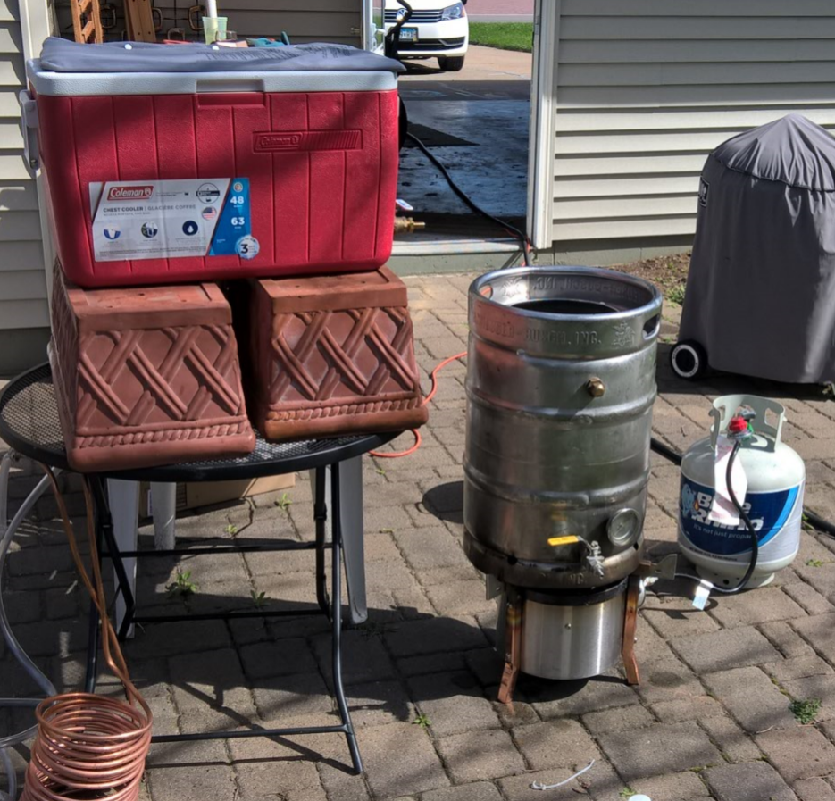
The Mash (Extracting Sugar FROM GRAINS)
“Mashing is the brewer's term for the hot water steeping process which hydrates the barley, activates the malt enzymes, and converts the grain starches into fermentable sugars.”
"- John Palmer
The Equipment (Mash Tun)
How to build
Notes:
You can buy a mash tun or you can build your own. Any standard 48 quart picnic cooler will work. What you

Slide 18
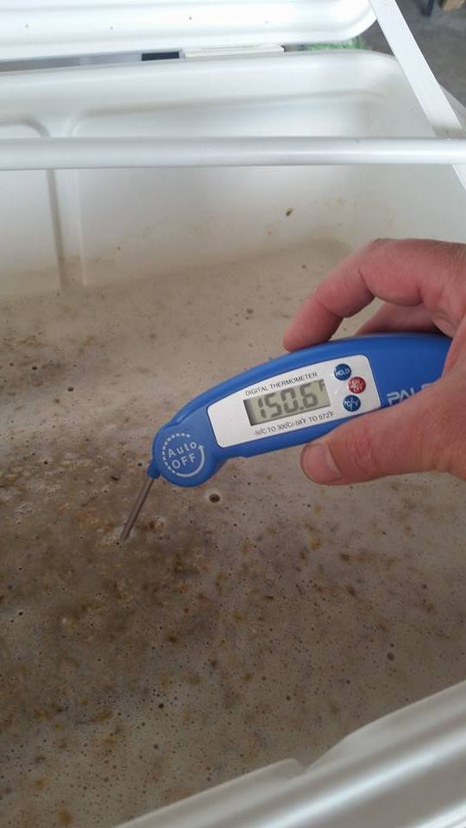
The Mash (Continued)
The goal is to get your grain soaking in water between 148-160 degrees for 60+ minutes.
Over 170 degrees will stop all enzyme reactions.
Under 140 degrees will not get the right enzymes extracted.
You don’t want the temp to drop more than 5 degrees during the mash.
A standard Coleman® cooler can do this without a problem.
Notes:
A bucket with blankets can keep its temperature for an hour. The mash is a really good insulator.

Slide 19
starting The Mash - WATER
Heat the Mash Tun! (add hot water, close the lid, swish it around)
Amount of water to use (Ratio) - quarts of H20 / lbs of Grain
1.5 is fine.
Strike Temp
(.2 / RATIO) * (TargetTemp – InitialTemp) + TargetTemp
Or appx 12 degrees hotter than your desired mash temp.
To hot? Stir it up. Too Cold? Add hot water.
Notes:
Heat the mash tun so as not to loss heat when adding water. Have thermometer handy, a grill thermometer works great.

Slide 20
Adding grain to the Water
Add the grain to the water. (Not water to the grain)
Check your temp and make sure you are at your desired temp.
Stir to cool, add water to heat it.
Pro Tip – You can also pull a gallon or two, bring it go a boil, and add it back (decoction)
Stir up the grains gently, but thoroughly! You have to break up all the dough balls in order to get good extraction. (3-5 minutes)
Have a big perforated paddle for this.
Close up the cooler and let the chemistry happen.
Notes:
If

Slide 21
ThE Mash – Geeking Out
Low Temp Mash
140 – 154 degrees
Higher fermentable sugars
Lower body beers
High Temp Mash
154 – 160 degrees
Lower Fermentable Sugars
Full bodied beers

Slide 22
Advanced Mash - PH
The desired PH level for your mash is between 5.0 and 5.6.
Depending on your water and grain this can be challenging to hit.
You can make good beer if your mash PH is off.
Every 10-15 minutes you can take a sample from the Mash tun and measure the PH and see how you are doing.
Manipulating the Mash
Grains -> Dark grains will lower your mash
Acid will lower your mash PH
Sodium Bicarbonate will raise your mash PH.
Notes:
The first few brews you do, don’t worry about PH. This is the fun stuff. If you are screwing around with this, either know your chemistry or use a tool to help you. You need an accurate water report and a decent PH tester if you want to get serious about controlling your PH.
You may be lucky and have good water and never have to worry about this. (i.e. Chicago)

Slide 23
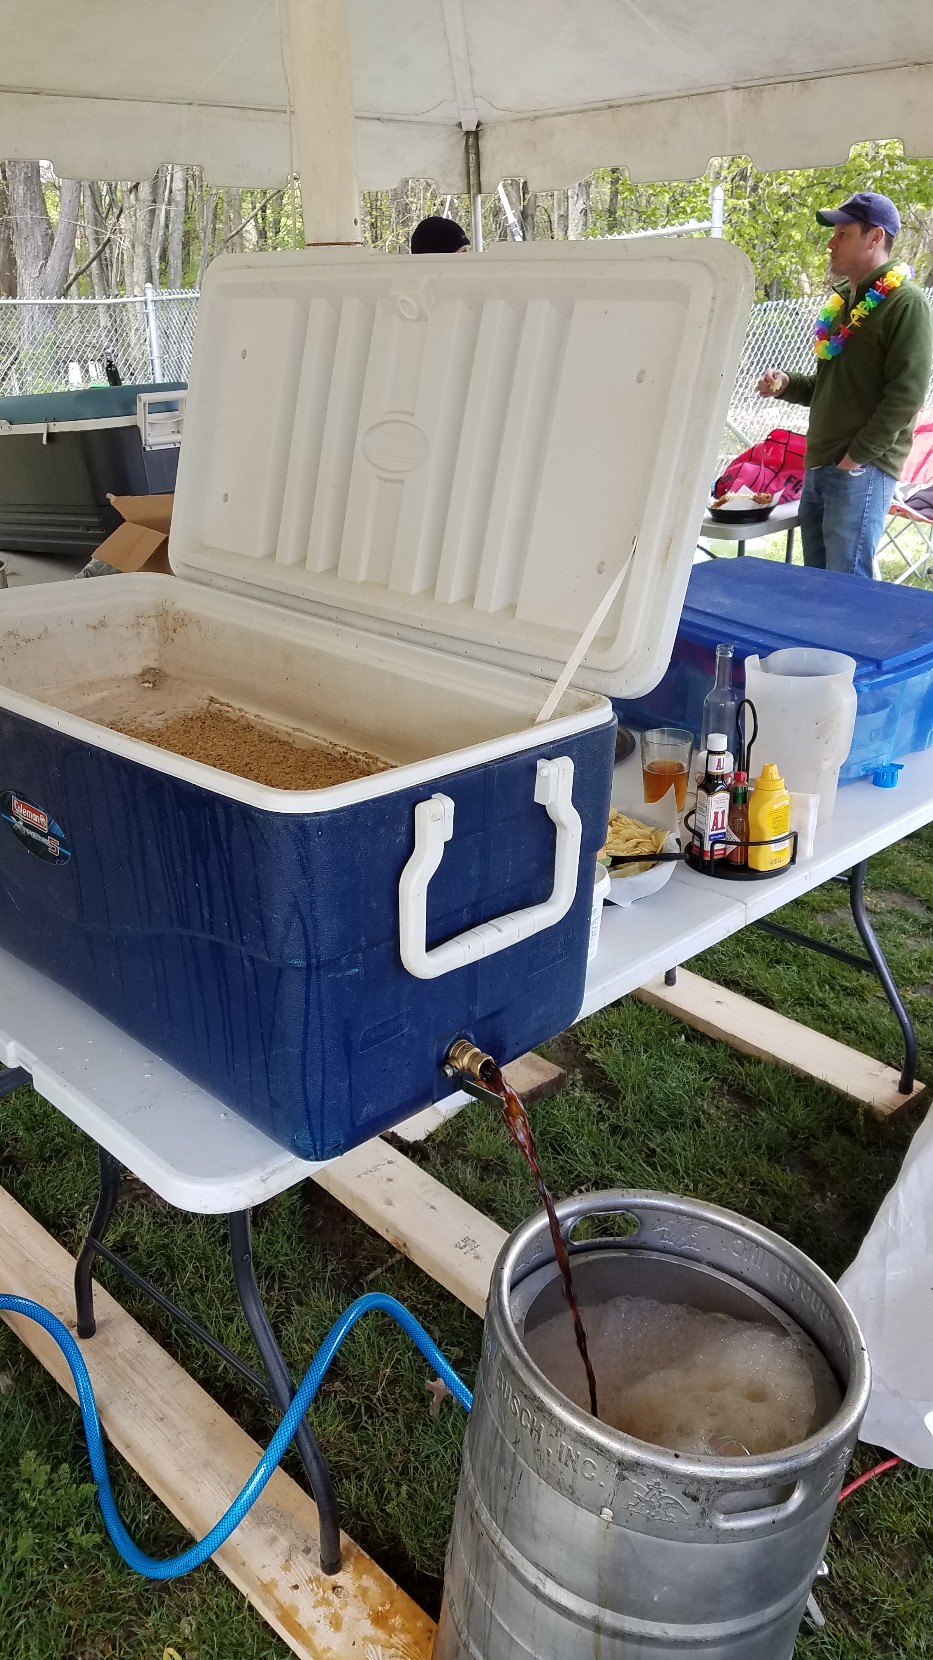
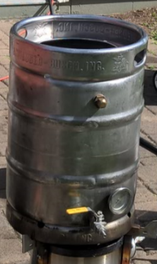
The Lauter, VOrlAuFing and Sparging
This is getting the wort out of our mash tun and into the boil kettle.
Equipment – Boil Kettle
Probably the most expensive piece of equipment if you buy it.
You can fashion a keg into one. (requires a propane burner)
Nice to haves –
Attached Thermometer
Size, bigger is better.
Handles / Grips
Notes:
A big boil kettle is nice to prevent boil overs and to be able to account for boil off or adding of water.

Slide 24
Extraction Percentage
The amount of sugar you extract from the grain vs. the total amount of sugar available is extraction percentage.
The Sugar is what turns into alcohol.
More grain = more sugar = stronger beer
High efficiency is harder with higher gravity beers.
It’s not always about the alcohol; balance is important
Can always boost with extract or other sugar sources
There is a lot that has to go right to get a high extraction percentage (%75+).
Notes:
A big boil kettle is nice to prevent boil overs and to be able to account for boil off or adding of water.

Slide 25
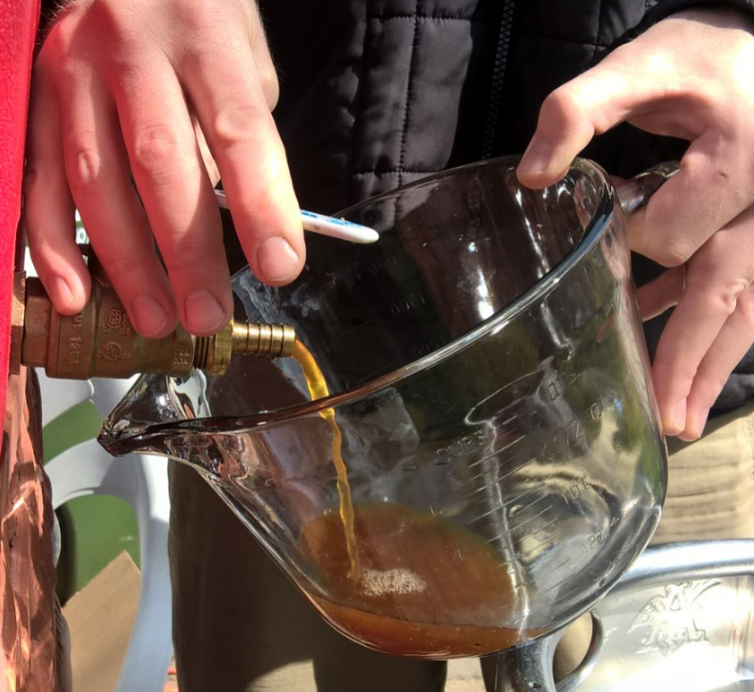
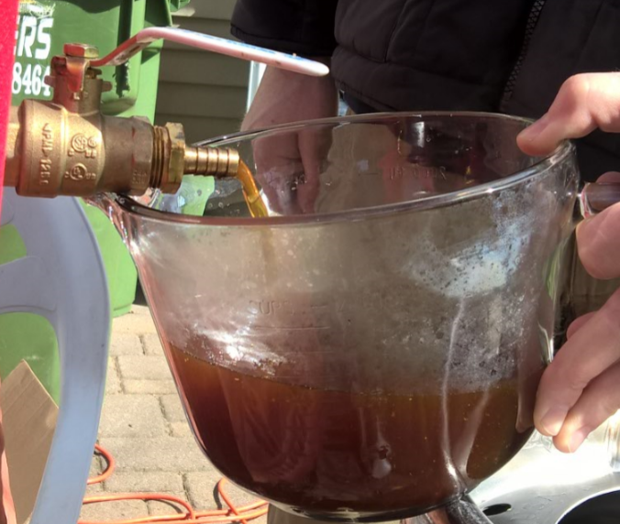
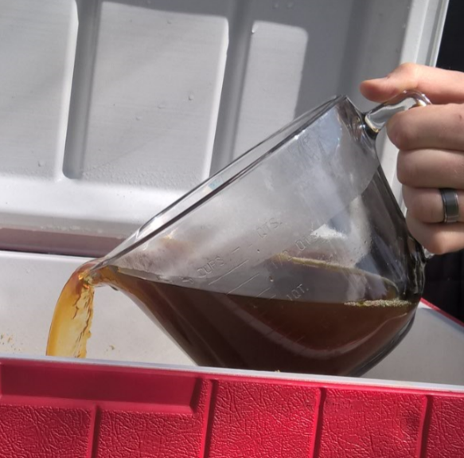
VOrlAuF
Take the first runnings from the Mash and pour it back into the mash tun.
Do this until the runnings are clear.
You cannot over do this but you can certainly under do it.
Notes:
If you do not do this enough times you cannot get good extraction. Period. Trust me.

Slide 26
Sparging
This is rinsing the sugars from the grains!
A good sparge is required for a decent extraction percentage.
Batch Sparge
Empty the mash tun into the boil kettle
Refill, do it again.
Continouos Sparge
Add water at the same rate you are draining it into the mash kettle.
Sparge until you get a 1.008 gravity measurement or you have enough wort.
Whichever is first.
Notes:
What is gravity!?

Slide 27
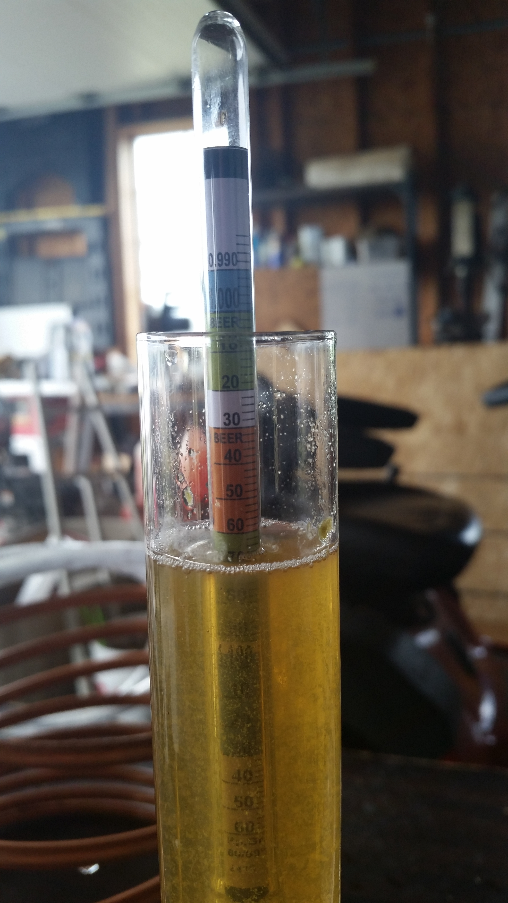
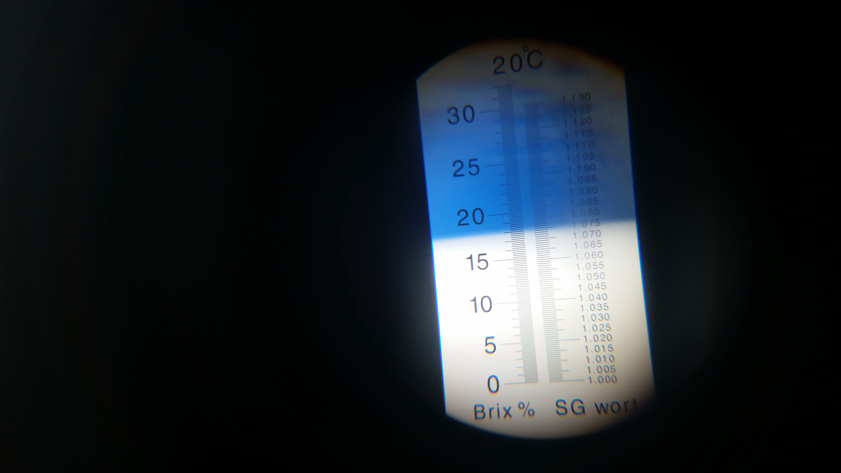
Gravity
The amount of sugar in your wort is measured based on a Gravity measurement.
You measure gravity using a hydrometer or refractometer!
ABV = (Starting Gravity – Final Gravity) * 131.25
Notes:
Wtf is gravity?

Slide 28
BOIL
Boil for an hour!
Boil overs are bad and horrible to clean up.
Turn the heat down once the boil starts.
Saves on energy costs and prevents boil overs.
Add hops as you desire.
There is a lot of hops science out there.
General rule for hops? If you like the smell you will like it in your beer.
Your pallet is going to evolve as you homebrew.
The strong hoppy character of a beer will fade quickly. (90 days). Drink up.
Notes:
What is gravity!?

Slide 29
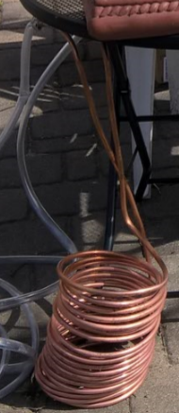
The Chill
You want to chill the wort out soon after flame out.
Chill the wort a few degrees colder than fermentation temperature.
Agitate the beer as you chill it.
Why Chill? Dimethyl Sulfide sucks. Once you taste it, the beer is ruined.
Immersion Chiller
Plate Chiller
Ice Bath
Combo
Notes:
What is gravity!?

Slide 30
Fermentation
Wort + yeast + time = BEER
Step by Step
Add the chilled wort to a fermentation vessel (Carboy)
Aerate the wort. (shake it, pump it, etc)
Add the yeast (no more shaking / aeration!)
Seal it, add an airlock (or a blowoff tube!)
Wait 2-3 weeks…. Don’t touch it.

Slide 31
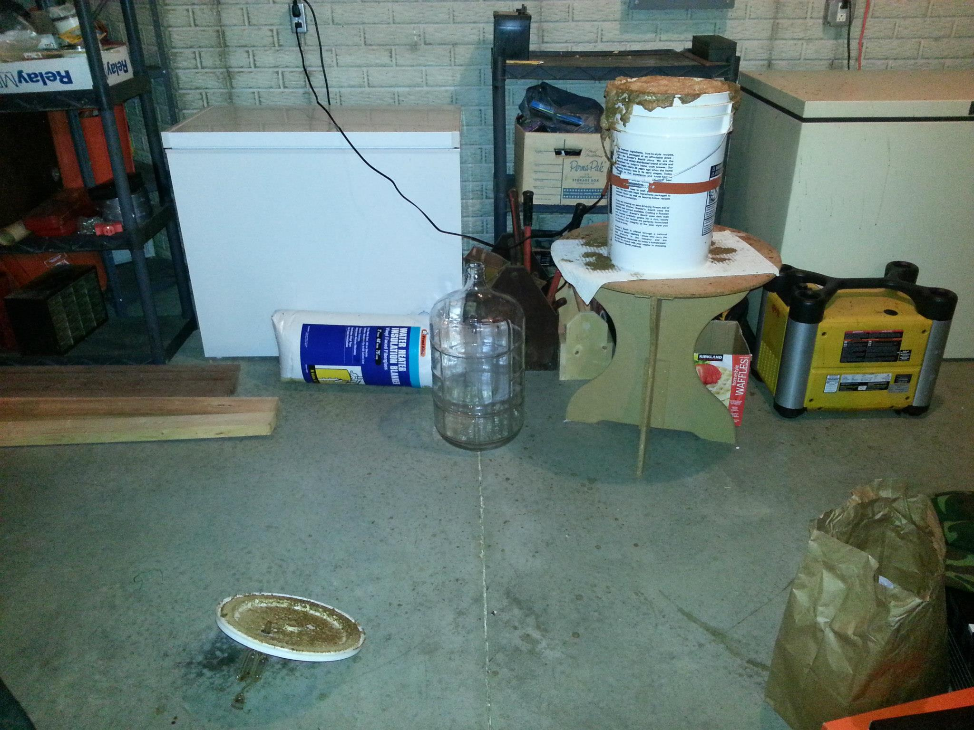
Fermentation
Temperature is important…

Slide 32
Yeast
Arguably the most important part of the brewing process.
A complete fermentation requires enough healthy and happy yeast.
Lots of Yeast science available.
Simple rule for a 5 gal batch.
Low gravity beer – 1 yeast packet (<50 gravity)
High gravity beer – 2 yeast packets (>50 gravity)
Dried yeast is awesome. Starters are awesome too.
You can’t use too much yeast. You can absolutely use too little.
Notes:
What is gravity!?

Slide 33
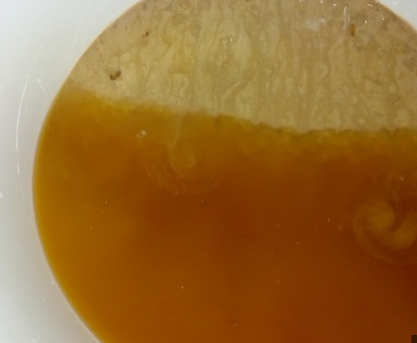
Yeast Cakes
For high gravity beers or if the timing permits, use the yeast cake from a previous fermentation.
http://beersmith.com/blog/2008/07/25/yeast-washing-reusing-your-yeast/
https://www.reddit.com/r/Homebrewing/comments/33p6g8/reusing_the_yeast_cake/
Or, find your local brewer and ask for some of their yeast.

Slide 34
Fermentation Vessels
Plastic vs Glass
Glass
Fragile, Harder to clean, expensive.
Looks amazing, lasts longer.
Plastic
Durable, easy to clean, cheap.
20-25 brews or until scratched before replacement.
Lids can lose their seal. (they still work)

Slide 35
Secondary Fermentation
Moving the wort to a new container (carboy) after primary fermentation to help reduce off flavors.
Generally not needed for a 5 gal batch. It is more important for 500 gal batches.
Exceptions being for very high OG beers or lagers.

Slide 36
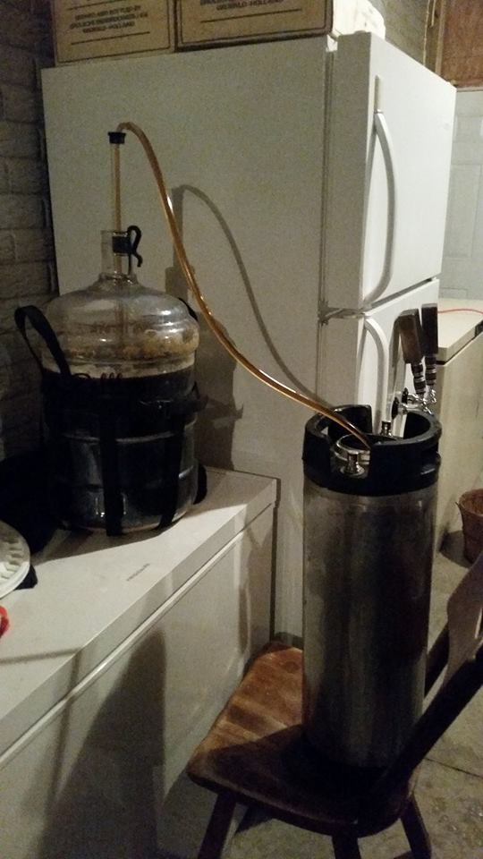
Bottling/kegging
Bottling
Wait until fermentation is DONE (bottle bombs are no fun)
Add a little sugar for the yeast in suspension to convert to CO2 (typically 1-3 weeks at room temp)
Not uncommon to have some precipitant in the bottom of the bottle
Use brown glass. Green/clear is evil
Kegging
Standard is 5 gallon cornelius “corny” kegs (soda kegs)
Two connector types: Pin lock and Ball lock
Force carbing: crank the CO2 pressure and rock
Can bottle off the keg if you want to take it with you

Slide 37
Brewing Automation
IoT - Intoxication of Things?

Slide 38
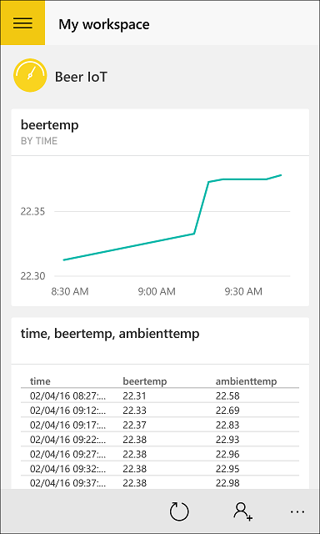
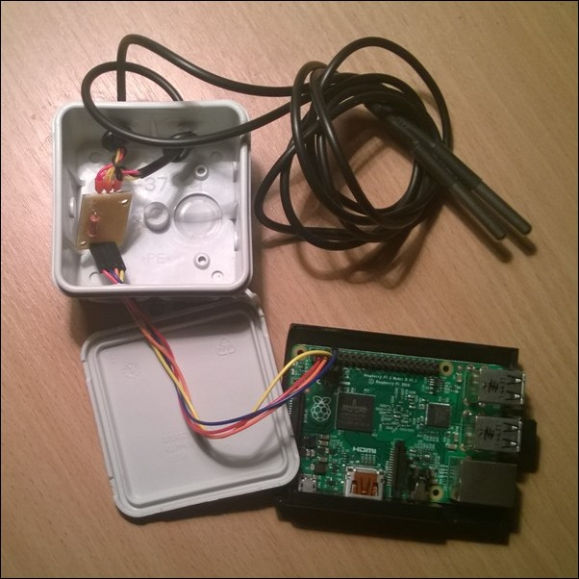
Brewing Automation
You can automate some or all of the brewing process
Temperature is the most common measurement point
Challenge is regulation…electric is easier and safer, propane not so much

Slide 39
HELPFUL LINKS
Homebrewfinds.com – Great for getting deals on brewing stuff
Homebrewtalk.com – Brewing discussion forum. TONS of recipes, tips, and info
https://www.brewersfriend.com/dilution-and-boiloff-gravity-calculator/ - Useful gravity calc
https://www.bjcp.org/stylecenter.php - Style guidelines for certified beer judging
http://www.beersmith.com – BeerSmith brewing software (check out podcast too!)
http://bit.ly/beeriot - Brewing with Windows IoT
http://howtobrew.com – John Palmer’s brew guide.
http://reddit.com/r/homebrewing

Slide 41


Slide 42
agenda

Slide 43
Title
Line1
Bullet Level 1
Bullet Level 2
Bullet Level 3

Slide 44
Title
Code

Slide 45
Text Only with Border
Level 1
Level 2
Level 3

Slide 46
Text Only (Red)
Level 1
Level 2
Level 3

Slide 47
Title
Text 1
Level 1
Level 2
Level 3
Text 2
Level 1
Level 2
Level 3

Slide 48
Title
Section 1
Section 2
Text
Level 1
Level 2
Level 3
Text
Level 1
Level 2
Level 3

Slide 49
Demo Title

Slide 50





























Slide 51






























Slide 52




























Slide 53




























Slide 54




























Slide 55




























Slide 56




























Slide 57























Slide 58
















